Slide 1
Media to Movements (M2M)
M13 – Matthew 13
Nov 2019

Slide 2
I… Peoples Network
(since 1991…)
Research (& UUPG)
Prayer (& Kids mobilization)
Mobilization
Field CPM (Church Planting Movements)
Member Care
Media to Movements (M2M)
Church Coaching (after mobilization)
Partnership Development (Regional Networks)

Slide 3
M2M: Why-What-How…
Why? To see local indigenous Church Planting Movements (CPMs) among every Unreached People Groups (UPGs) in ...
What? M2M is a partnership focusing on catalyzing movements among the UPGs of … (often called the majority people of …), through effective CPM media initiatives and CPM field efforts.
How? Media (projects/initiatives/teams) serving Movements – by identifying Potential Person of Peace (PPOPs) who can then further be disciple (face to face) by field teams.

Slide 4

That means…
Not measuring how much someone likes our content (video & article).
But focusing only on the real goals:
  People grouping in scripture
  discovery study groups
  Multiplying
  Disciples and Churches

Slide 5
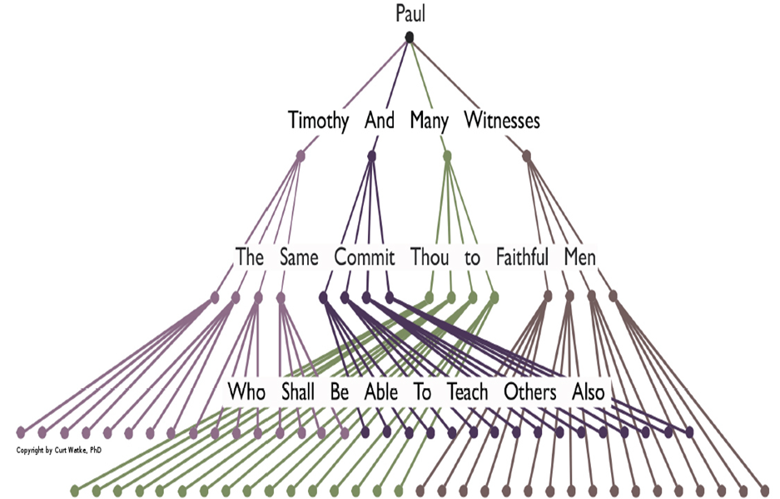
PPoPs & Multiplication
2 Timothy 2:2 (NKJV)
And the things that you have heard from me among many witnesses, commit these to faithful men who will be able to teach others also..
Person of Peace
Matthew 10:5-15
Luke 10:1-12

Slide 6

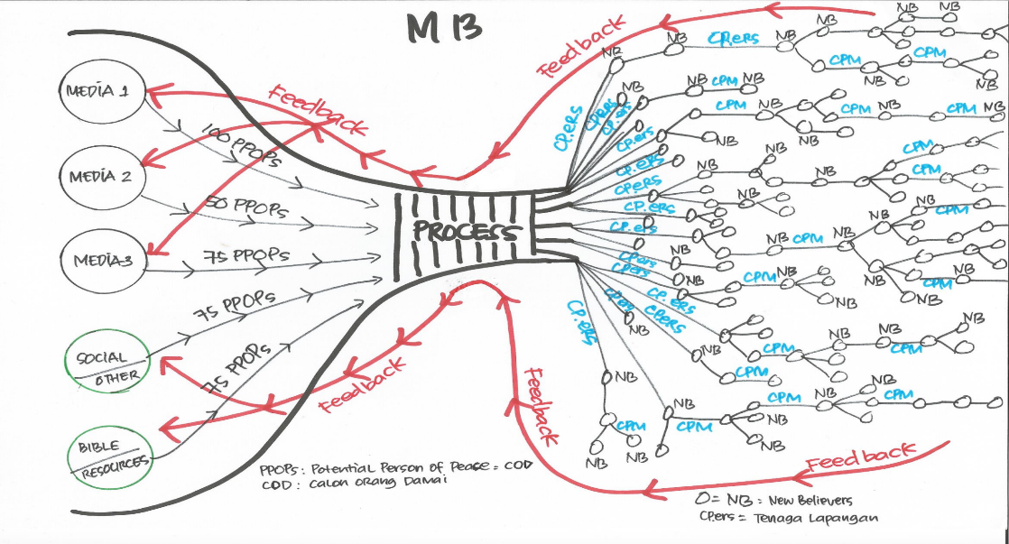
Diagram M13
Media
Field
PPoPs
F2F
Contacts
DBS/Group
Church
Viewers
Timeline
Movements!

Slide 7
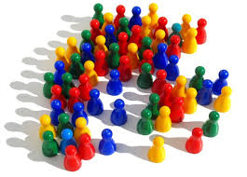
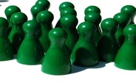


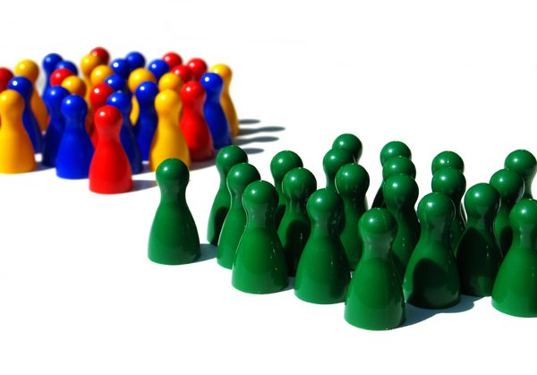
FILTERING PROCESS

Slide 8
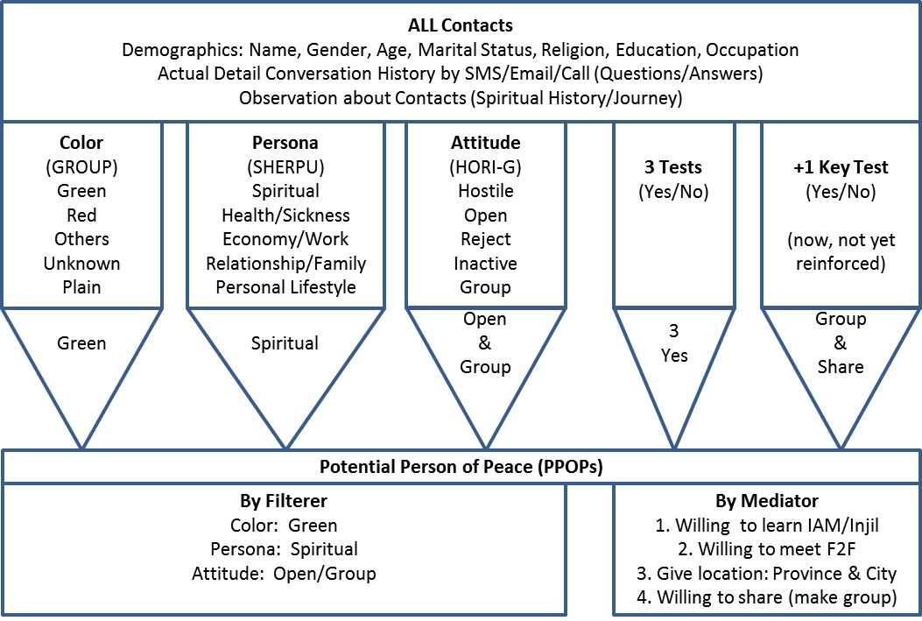
The Filter - Media Side

Slide 9
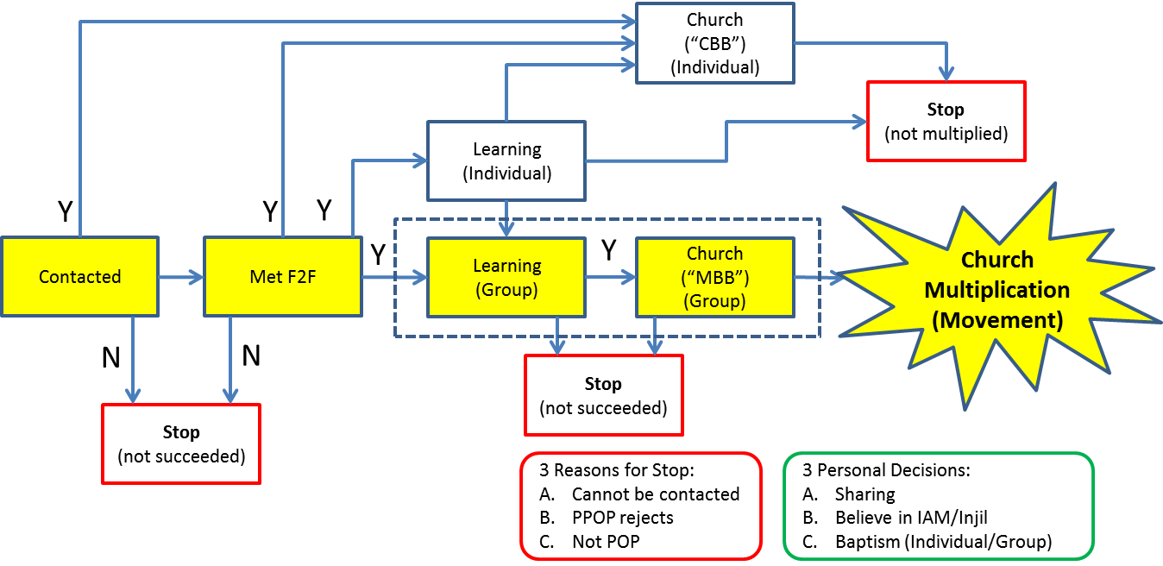
The Process - Field Side

Slide 10
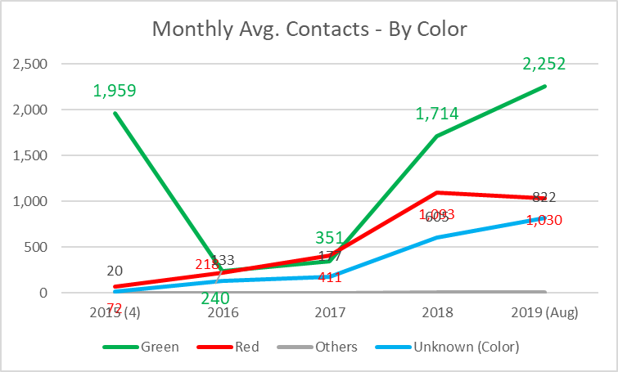
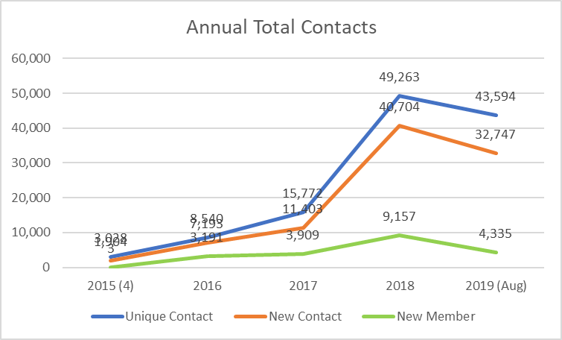
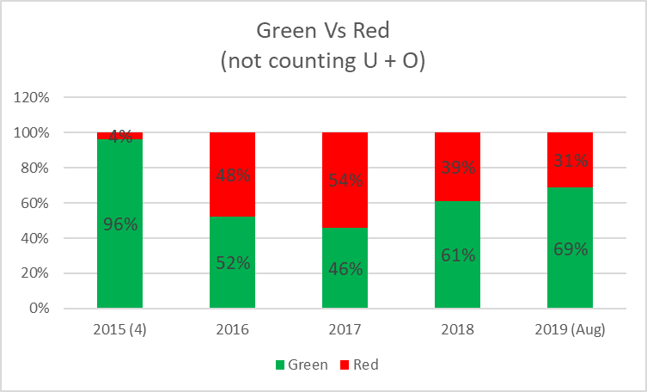
Contacts (Unique)
Coloring is IMPORTANT!!!

Slide 11
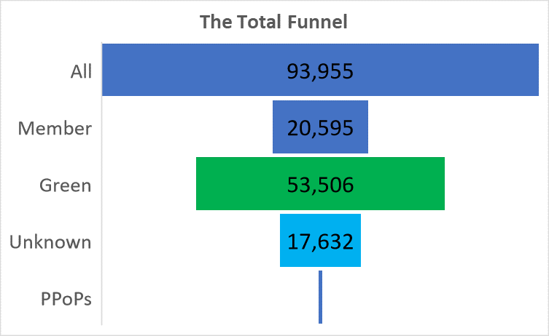
The Total Funnel (Jan ‘14-Aug ‘19)
797
Reminder:
Only 22% are Members (giving some information),
Therefore coloring is VERY important!

Slide 12
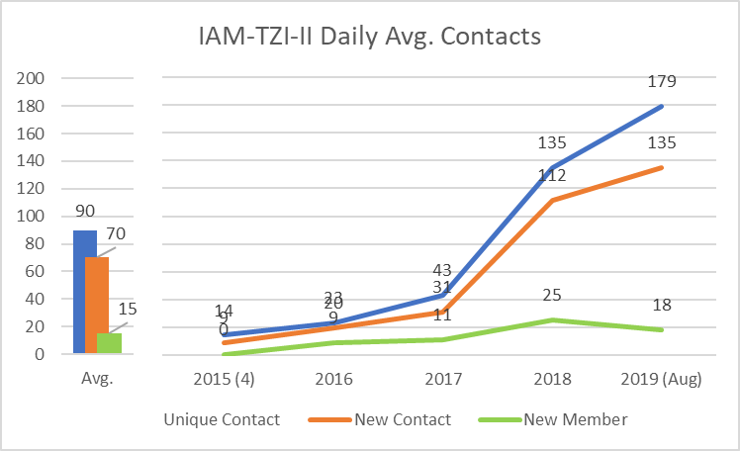
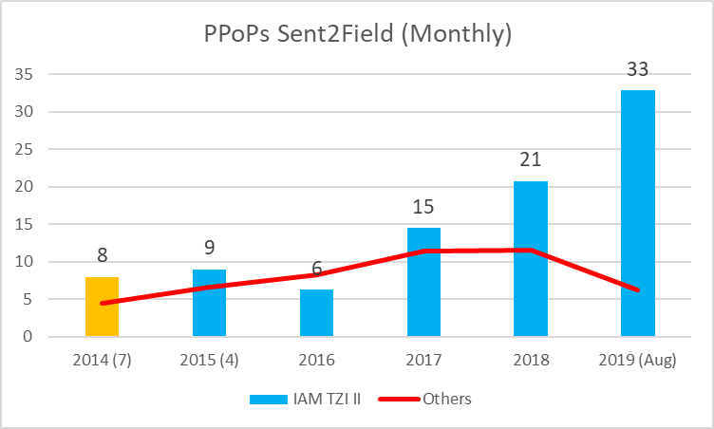
The Daily Funnel…
179 contacts per day
69% green (123/day)
1-2 PPoPs per day (1.5% of green)

Slide 13
T… Z… I…
May ’17 – Oct ‘19
Page Views (Web)
1.6 mio
Net Download
12,000
App Download
72,000
Visitors (Web)
0.7 mio
Reach (FB Ads)
9 mio
Visitors (FB)
0.8 mio
Hours in Web
2.000
FB Followers
66.000
Contacts 11,500
Green 81%
PPoPs 223
(2.3 % of Green)
Faith
31
Baptized22
Sharing 24

Slide 14
The Multiplication
Stick Rate
PPoPs
223
Learning (DBS)
39 Individual + 15 Groups
Congregations (MBBs)
24
Sharing 24
Groups 15
Church
Multiplication
G0 (CBB) Goer vs Gx (MBB) Leader
Individual vs Group

Slide 15
M13 Current Partners
Media Partners:
Satellite TV (…)
Kitab … (Website + App)
New Scripture … (Website + App)
6 Websites Apologetics + 3 FB (…)
… (Discovery Stories + Testimonies)
… (national TV programs)
… (specific language TV programs)
… (FB + website)
… (Kids App + FB for mother)
… I… (Website + FB)
(+ local field teams)
Field Partners:
Foreign Sending Agencies
Local Sending Agencies
Local “CBB” Church
Individuals (independent)
Network (Movements)
The Spread!
34 of 34 provinces
383 of 514 cities
1300 of 7094 districts

Slide 16
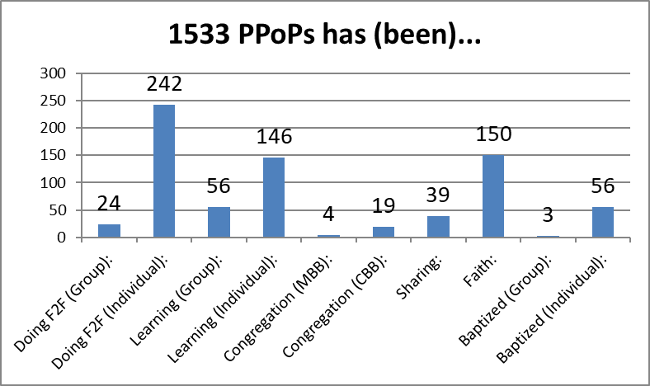
Field Status

Slide 17
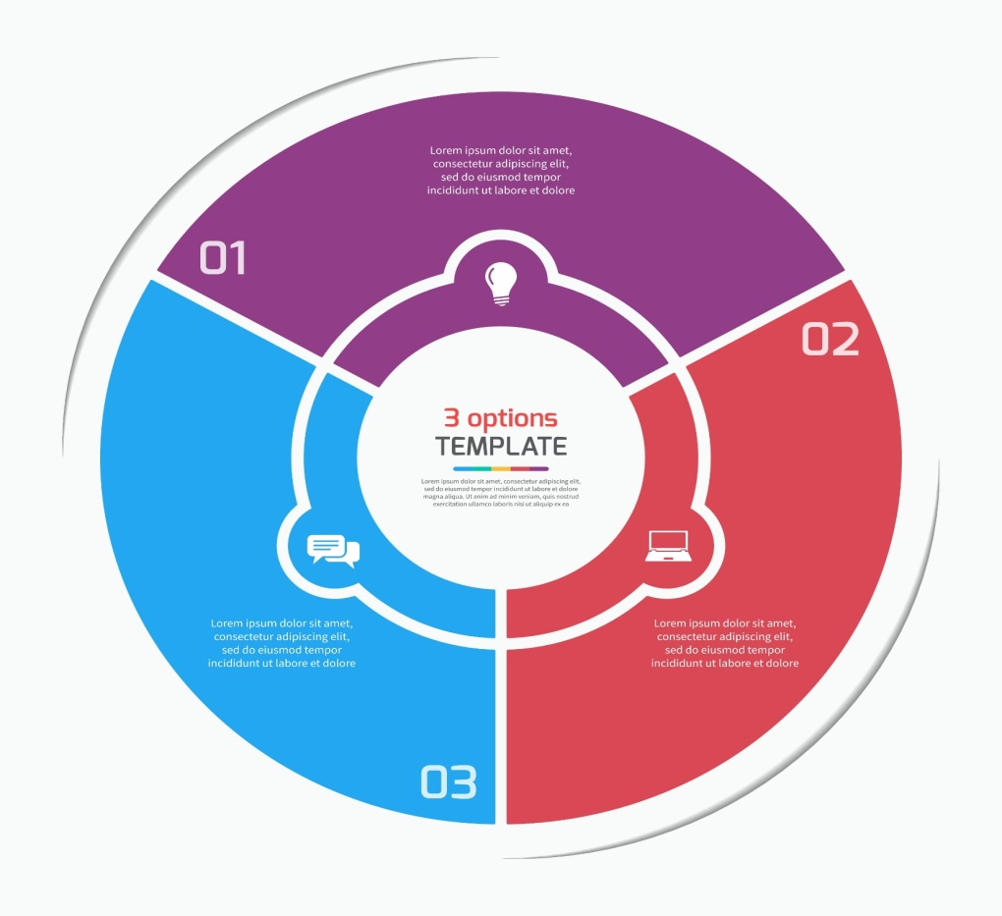
Your Specific (many!) Roles?
MEDIA…
Creative
Marketing
Communication
System/Technology
Strategy/Process
FIELD…
BOTH:
Prayer
Fund
Content
Media Roles
Follow Up
Distribution
Technology
Strategy
Field Roles

Slide 18
Together for Ethne…
Revelation 5:9-10, International Standard Version (ISV)
9 They sang a new song:
“You are worthy to take the scroll and open its seals,
because you were slaughtered.
With your blood you purchased us[a] for God
from every tribe, language, people, and nation.
10 You made us a kingdom and priests for our God,
and they will reign on the earth.”
Media2Movements@gmail.com

Slide 19


