Slide 1
Global “Practitioner Issues” Event
April 29, 2025

Slide 2
Hosted by
The Digital Disciple Making Network Lead Team Partners:
East West, Frontiers, IMB, Jesus Film Project, Kavanah Media, Gospel Ambition, M13, Media to Movements, Mission Media U / Visual Story Network, OneKingdom, TWR Motion

Slide 3
Mission
We exist to equip disciple makers to accelerate movements with an end-to-end strategy with an emphasis on least-reached people.

Slide 4
Uniqueness
Our leadership team is composed of those with the capacity to provide training, mentoring and media resources to a broad base of practitioners.
We emphasize media strategies that begin with the end in mind, focusing on making disciples who make disciples.

Slide 5
Our Story: Part I
2000: An Arabic web site and follow-up strategy was formed to find seekers.
Late 2000’s
Dr. Frank Preston did research on how people were reached online and began to think about how to use digital strategies for disciple-making
An innovative team in North Africa launched an evangelistic website and built a country-wide network to facilitate face-to-face follow-up.

Slide 6
Our Story: Part II
2012: Based on Dr. Preston’s research, a media initiative was started in SE Asia that is now locally led involving a country-wide network.
2014: A “Media to Movements” team and blog was formed by a mission organization. This began to inspire and train other teams.
2015-2018: Other training, media and technology efforts emerged like
Kingdom.Training
Mission Media U
Social Media for Missions
Kavanah Media
Share the Story
Disciple.Tools

Slide 7
Our Story: Part III
2019: The “Media to Movements Coalition” was formed bringing together the various organizations involved in media initiated disciple-making.
2020 - present: An ecosystem emerges involving training, prayer, research, metric-tracking, regional hubs and communities of practice.

Slide 9
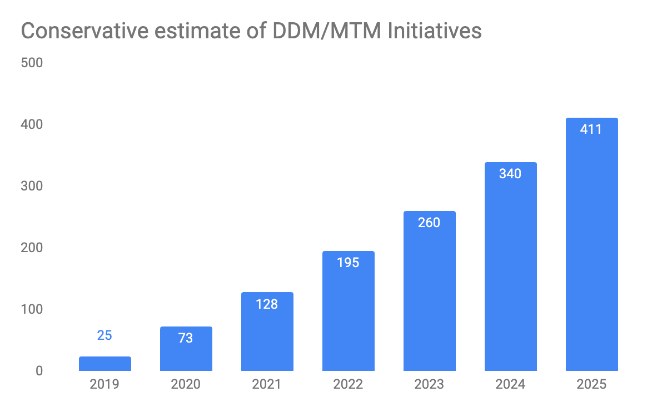

Slide 10
Our Story: Part III
2023
To distinguish between the team that helped launch the media strategy and the network that began in 2019, we changed our name from the Media to Movements Coalition to the Digital Disciple Making Network.
The new name also reflects the partnership’s expanded vision to be more inclusive of all digital efforts that focus on "making disciples who make disciples" among least-reached people.

Slide 11
Why a Global Practitioner Gathering?
There is no global meetup among practitioners to learn from one another about issues common to most teams.
It would be wise for practitioners to share their learnings, reduce duplication and accelerate more teams using media strategies for disciple-making.

Slide 12
Desired Outcomes
Begin to create a sense of the global nature of the practitioner community.
Inspire current practitioners to continue.
Provide help on challenging issues common to most practitioners

Slide 13
Target Audience
Practitioners who are using a media strategy focusing on making disciples who make disciples.
We recognize there are different understandings of field strategy (DMM, 4 Fields, local church introductions, online groups) and media strategy (media to movements, Discover Jesus Initiative, individual “grassroots” outreach, etc).

Slide 14
Topic
“Best Practices & Troubleshooting in Partnership Building”

Slide 15
Meeting Format (times are in UTC)
15:00 Welcome
15:10 Presentations
15:40 Q&A
16:00 Breakouts
16:07 Regroup and Share
16:15 Final Q&A
16:25 Next Steps / Resources
16:30 End

Slide 16
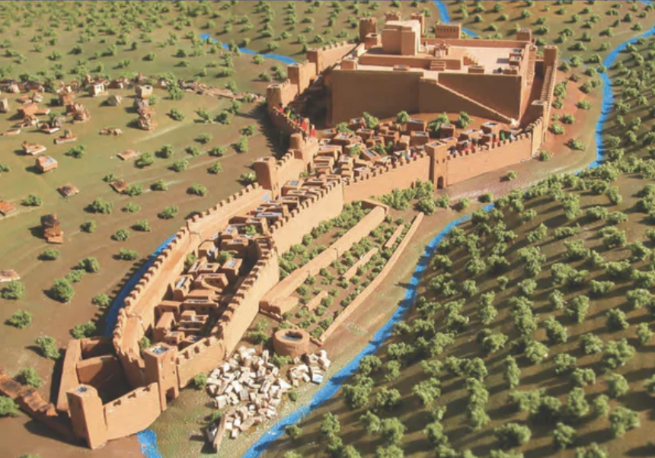

Slide 17
How confident are you in your ability to discern who to partner with in your digital to disciple-making efforts?
Notes:
How would you rate yourself in your ability to discern who to partner with in digital to disciple-making efforts? (1-5)

Slide 18
Filters For Effective Partnership
Connection
Calling
Clarity of mission
Commitment

Slide 19
Connection
Principle: People over projects
“By this shall all men know that you are my disciples, if you have love one for another.” John 15:35

Slide 20
Calling
Principle: Go slow and evaluate regularly

Slide 21
Clarity of Mission
Principle: Measure what matters- both qualitatively and quantitatively

Slide 22
Commitment
Principle: Partnership is an investment. It should be appropriately discerned and not entered into lightly.
Tool: Partnership documents

Slide 23
Breakout Discussion Questions (5 minutes)
- What did you hear from the presenter?
- What would you like to understand more about from the presentation?
- What do you want to take and adapt/adopt for your strategy?

